Slide 1
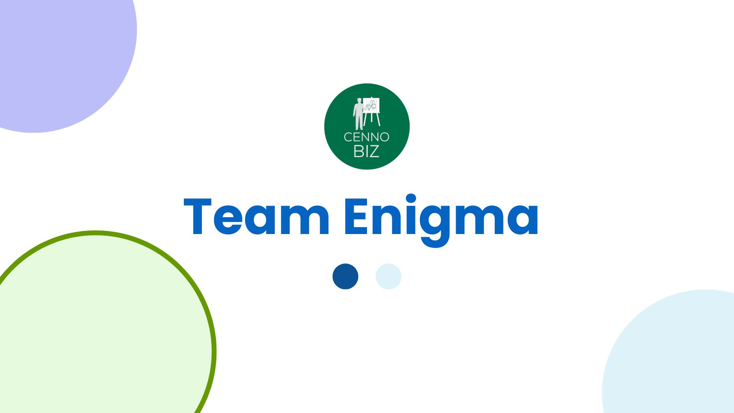

Slide 2



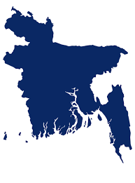


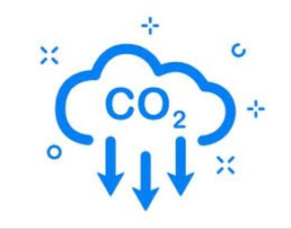




Situation Analysis
What is happening within our borders?
Facing challenge in fish feeding and
lack of awareness at this matter !!!!
Fossil fuel used per year for fish feeding.
Bangladesh uses 100,000 tonnes.
Less efficiency of aquaculture operation
10 Million Tonnes
40%
The Unsafe Water Tragedy Environmental Pollution, Waste Mismanagement & Flood
Bangladesh’s GHG emission rate
20-30%
Food Waste
1.87%
Fisheries Specialist, BAU
"Fish feeding is a critical component of fish farming, and it is important to do it efficiently and sustainably. Overfeeding and hand-feeding can lead to a significant amount of wasted feed, which can pollute the water and reduce profits for farmers.
300-400 Tk/day
Labor Cost
Source: ASC-AQUA.ORG, Dept of Fisheries, UNICEF
2

Slide 3



Problem Analysis
Why are we in this Situation?
Health crisis
Environmental Crisis
Economic crisis
Food Safety Concern
If feed not handled properly
Contaminated with Bacteria
Leads to food poisoning in Human
Air pollution: 3.68 Million GSG
High labor cost for small scale farmers
Estimated $10 Million
Water pollution: Water contaminated food
Lead to fish diseases
10 Million tonnes of waste
Low feed efficiency:
Increase cost
Waste more food(30%)
Reduce profit(20% less profit)
Due to less efficiency
Slower fish growth (10-27% less growth)
Source: NIH, Daily Star, WHO
3

Slide 4







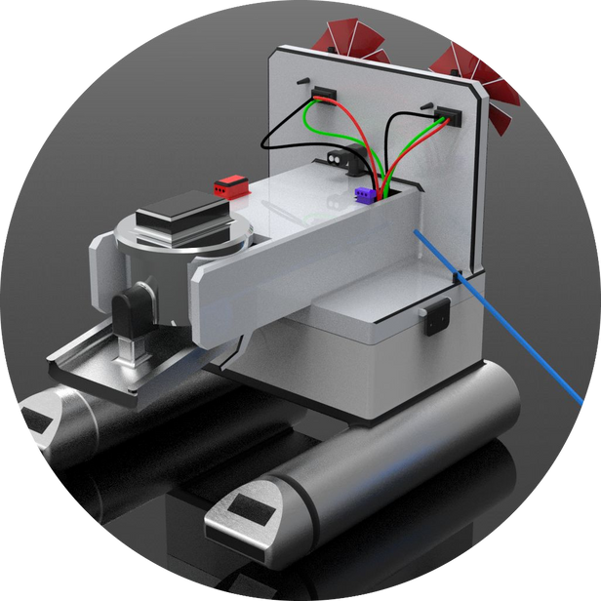








Our Solution
Our fish feed & aquaponic technology
Energy independent.
Eﬃcient feed distribution.
Powered by solar panels and is CO2 neutral.
Optimize food waste hatcheries.
in
Data driven decision.
Calculate
the aquaculture of pond.

Slide 5

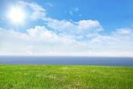





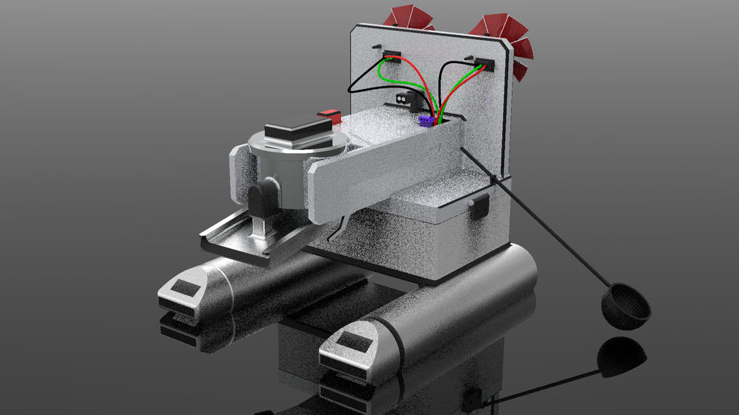




BARTA APP
Product Overview (Barta App)
Our developed application
05
pH Value of your wtater
Have to polish water
Updated news will
be sent in mobile
via SMS.
Calculating all the values from sensors.
Measures all the values via sensors
Real Time Monitoring
The value of pH of the water.
The value of Dissolve Oxygen in water.
The amount of fish feed that is need to deliver.
All data will be restore in our app “BARTA”.
Previous data will be restored in our app.
Smart Q/A
Analysis of previous and present data will give an extra advantage.
An automatic chatbot to mitigate any situation.
A strong customer care for their any urgency.
Precisely
Eliminating
DO Sensor
fish feed distribution
Extra elements
of ponds.
Measure O2 level.
pH Sensor
History Analysis
Measure pH level.
History will be saved due to better analysis.
Having all data will lead towards a good directions..
How it works???
EHow to enter the market

Slide 6
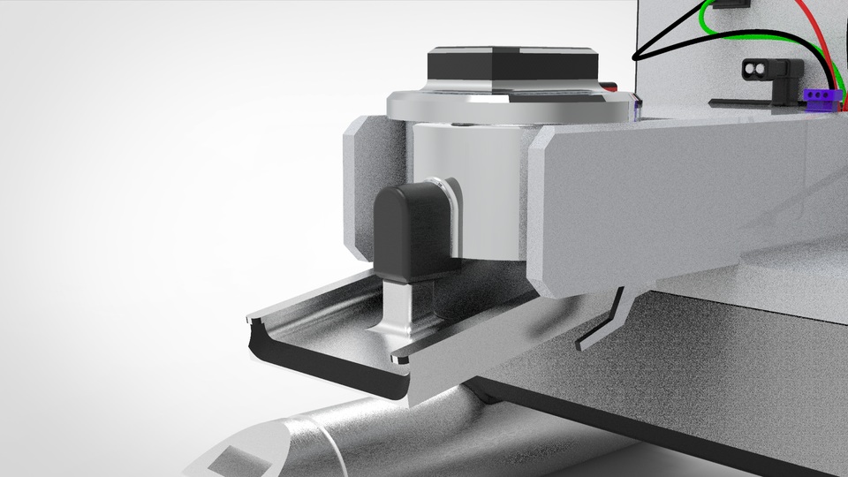
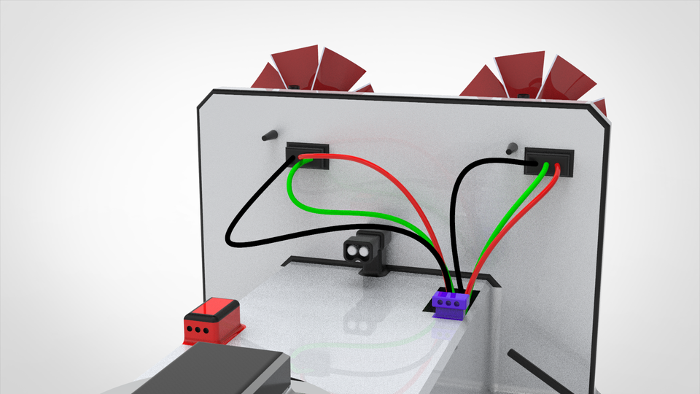
Product Overview
How it works on water (Fish feed mechanism)
Provide fish feed precisely
after a specific time
interval by progressing to
different points of the
pond.
No water blending by the
movement as it will be
operated through wind
power ensuring full safety
of the fishes.
If any harmful material falls or
algae layers form on
the pond our robot can
eliminate that.

Slide 7
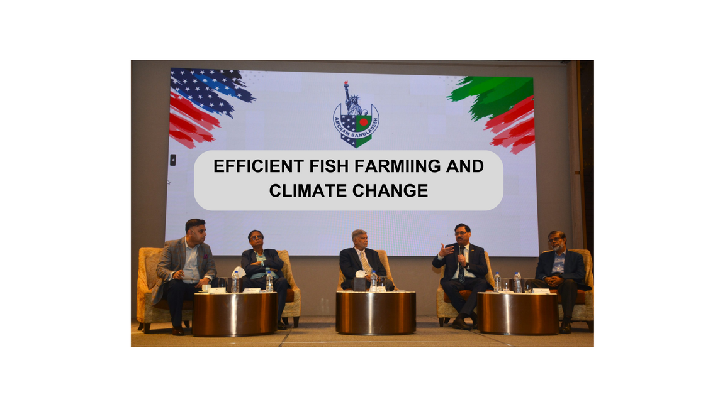
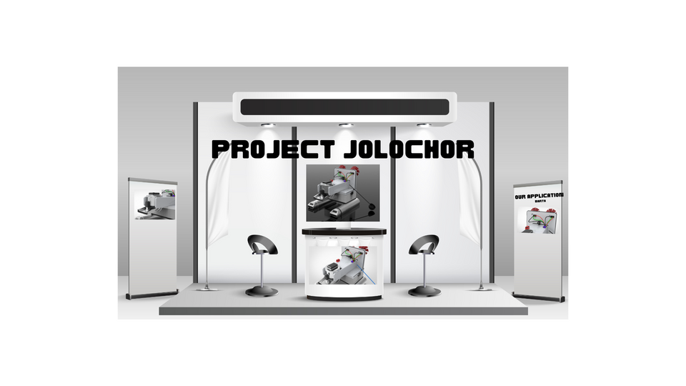
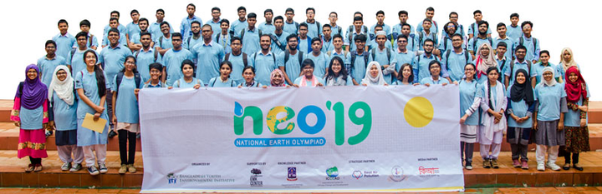

Marketing Plan
EHow to enter the market
Awareness
Engagement
Action
Environment Olympiad
Panel discussion in World Food Day
Arranging olympiad about environment.
Attending several innovation and agriculture expo
Objective
Objective
Objective
Product Familiarity with general mass.
Demonstrate Versatile use from street level.
Create a community dedicated to Sustainability.
Brand Positioning as Impact Brand.
Highlighting Product Versatility to improve life.
Opportunity to collaboration
Attracting our TG customer.

Slide 8
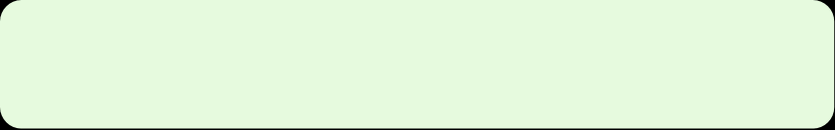
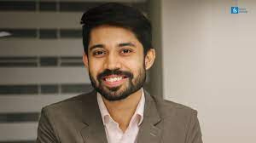
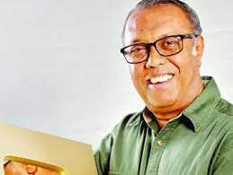





Marketing Plan
EHow to enter the market
CELEBRITY AND INFLUENCERS ENGAGEMENT
CABLE TV & RADIO COMMERCIALS
Leveraging celebrities’
goodwill to promote
through videos and
podcasts, which we will
sponsor.
Showing our project in many tv show
like “Bigganchinta”,
“Mati o Manush”, “Ruposhi Bangla”.
SOCIAL MEDIA PLACEMENT
Objective: To create awareness among people
about our innovation and product.
Starting a movement with the
#innovation_everyday on popular social media
sites including tiktok.
Objective: To engage the youth generation about
innovation and technology.

Slide 9
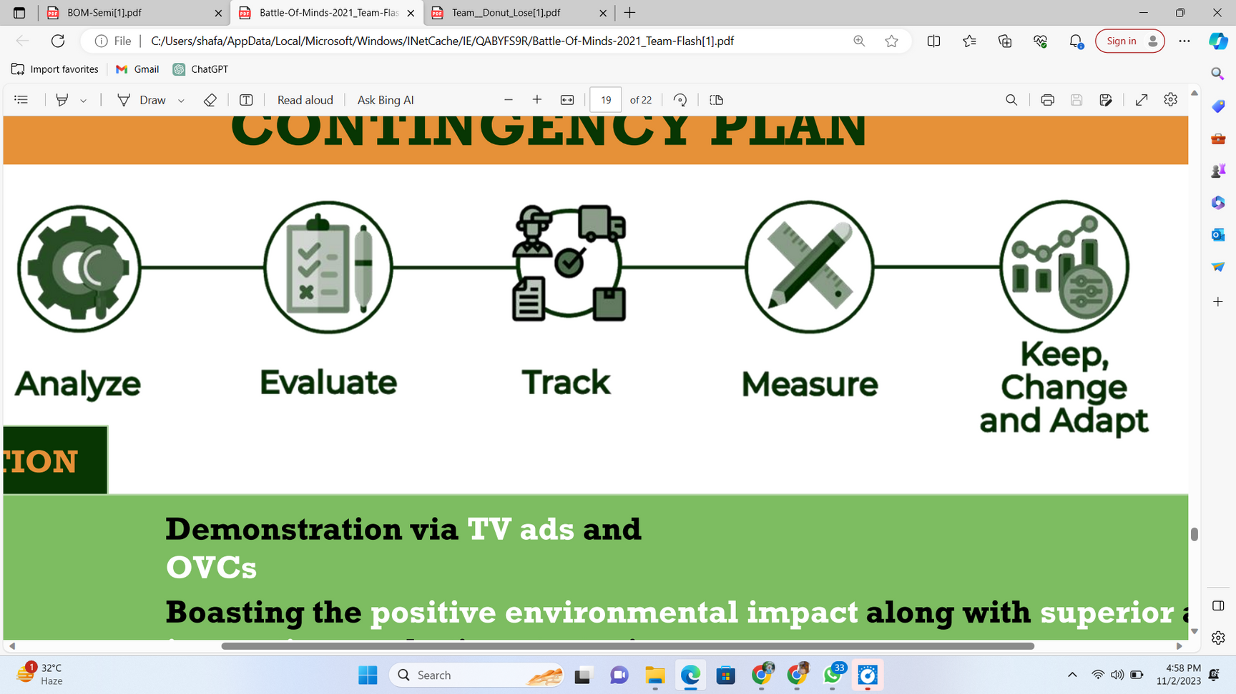
User Benefit
Why JOLOCHOR technology?
Category
Improvement
Impact of Jolochor
Distribution process implementation
Automatic precise feeding
1-2 times than before
Labor cost
Decreased 3-4 time than before.
Automatic precise feeding
Automatic precise feeding & real time monitoring.
Food waste
95% less than before.
Electricity cost
Free from electricity cost
Run by solar panel.
Proper growth & nutrition of fish.
Automatic precise feeding & real time monitoring.
60% more than before.

Slide 10





Revenue Model
Reason behind entering the market
Subscription Model
Solution Consultancy
Selling Our Product JOLOCHOR
PRICE: 350 BDT
PER MONTH
PRICE: Varies
PRICE: 17000 BDT
Service:
Access to our app “BARTA”
Get real time monitoring.
Get neccessary informations.
Service:
Selling our key product.
4 years of warranty.
Made with good raw material.
Service:
Depends on the situation.
Smart design of a farm.
Providing fish feed, medicines as per the situation.
Market Size
Our plans to take on challenges
Projected Market size of
2200 Crore BDT by 2028.
Compound annual growth
rate: 10%.

Slide 11
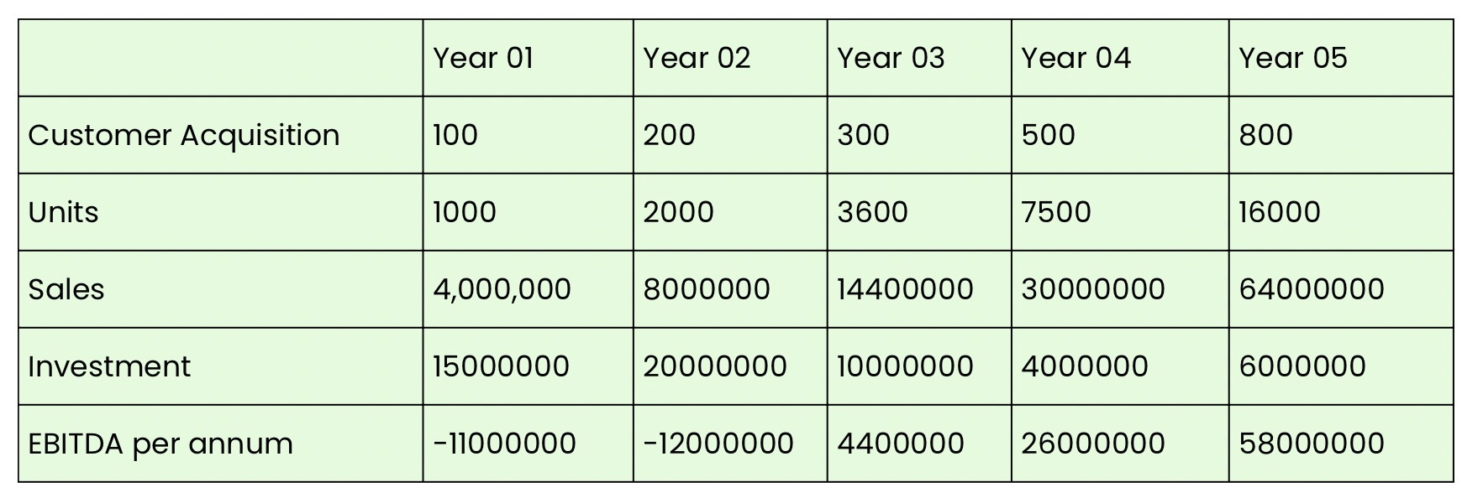
Financial Projections
Let‘s drive into numbers.
Break Even point Reached by 3rd year of operation
EBITDA by 5 years BDT 65400000

Slide 12
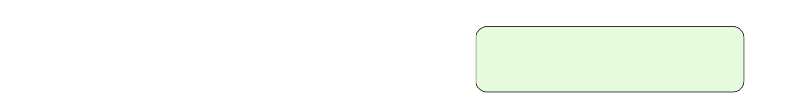


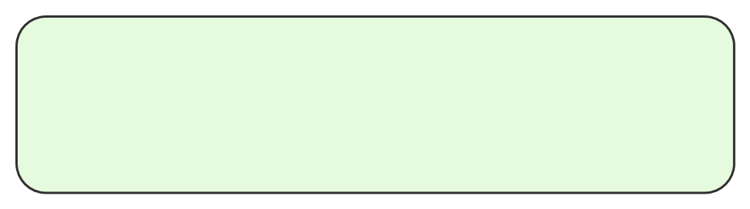

Financial Projections
Let‘s drive into numbers.
Investment by founder 2023
BDT 20 Lacs
BDT 80 Lacs
Investment by angel investor 2023-2024
To continue operations for 1 year before Pre-Seed Round.
BDT 80 Lacs
Investment by Pre-Seed 2024-2025
Ofﬁce rent Salaries
Pilot Project R&D Manufacturing Development Provisions
400000 500000 1200000 3000000 1900000 700000 300000
BDT 100 Lacs
Seed Round 2025-2026
BDT 300 Lacs
Series A 2026-2027
BDT 500 Lacs

Slide 13
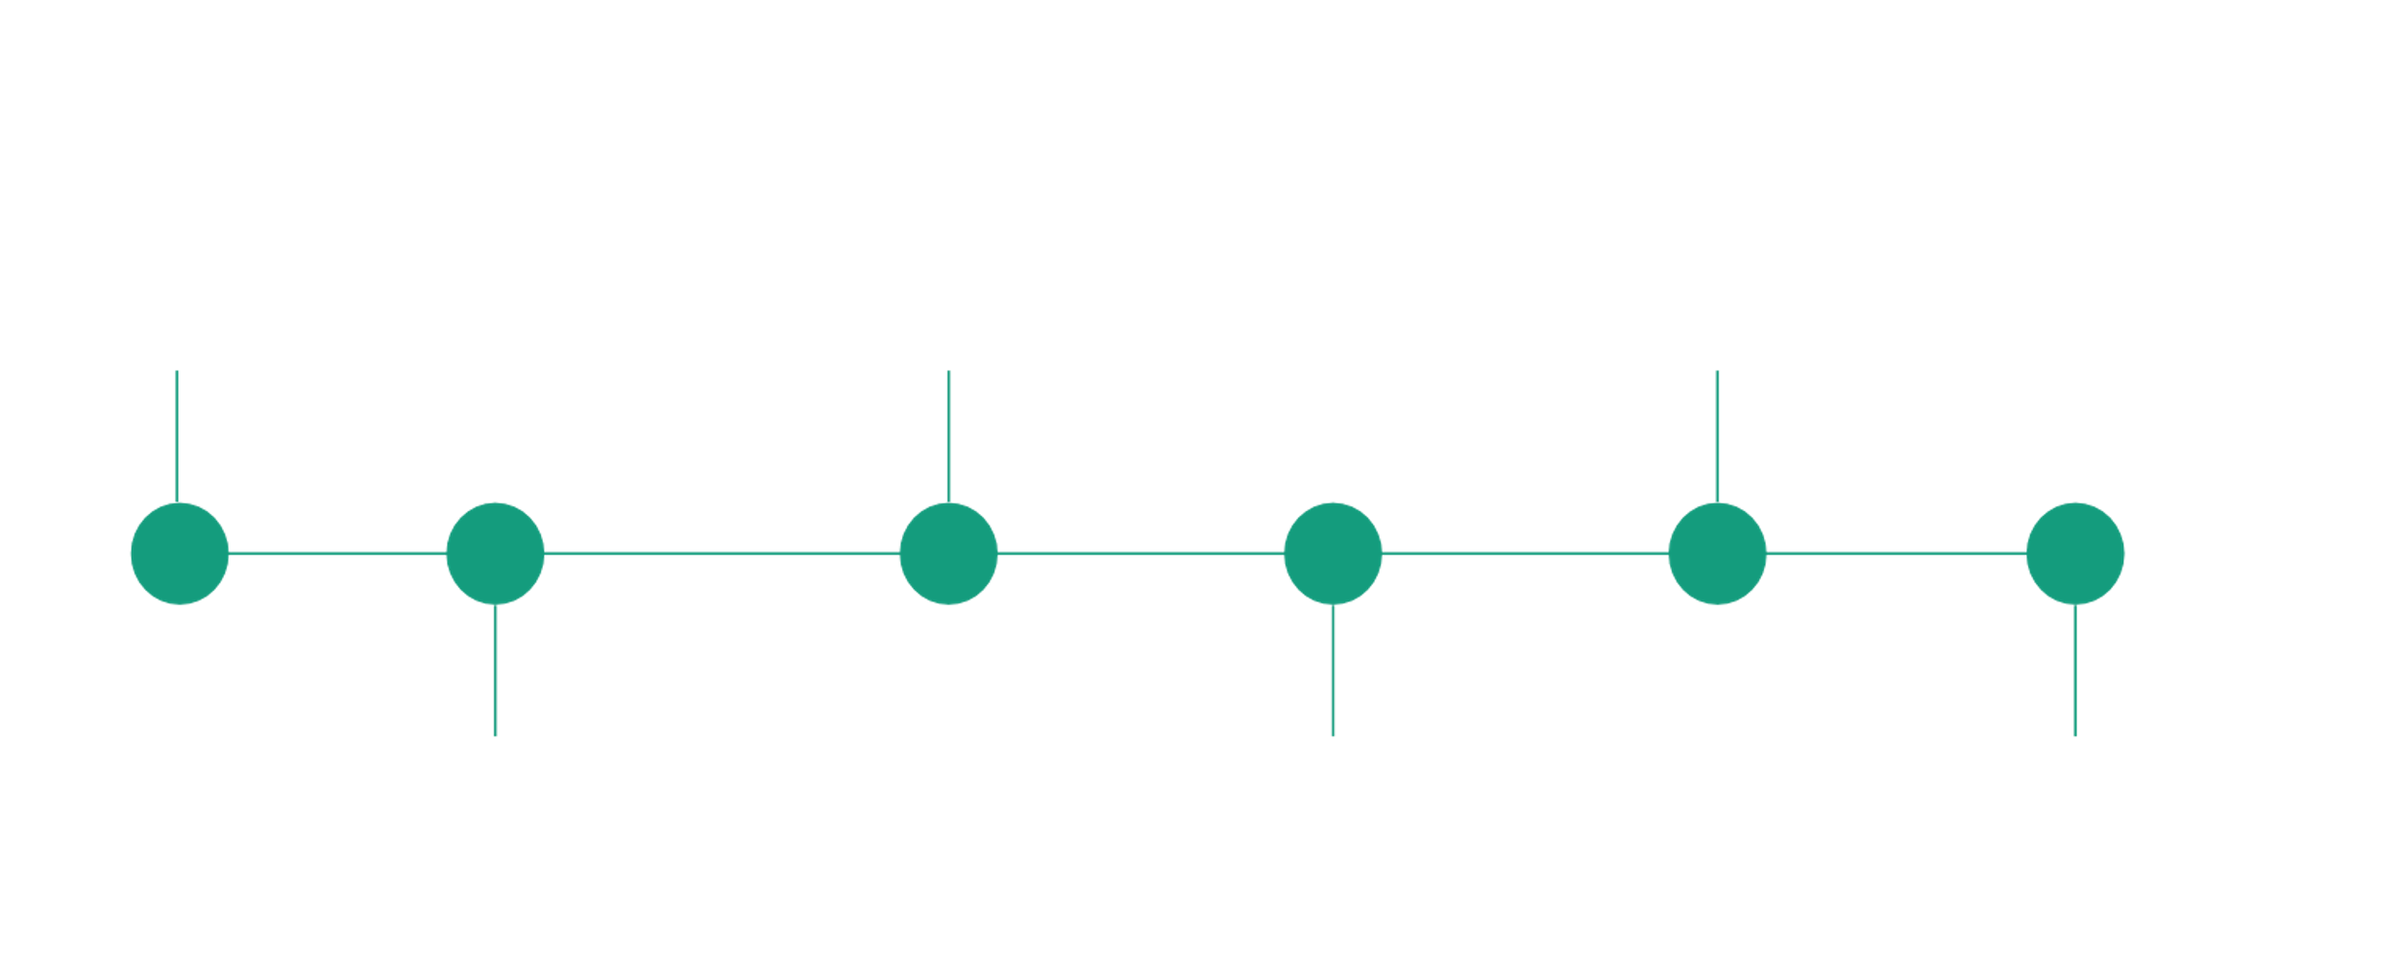








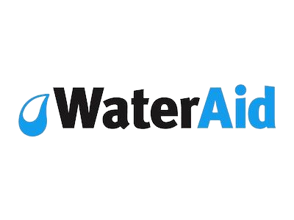



Implementation Timeline
1.Research and development
3. Initiate commercial sales
5. Break even point.
3-6 Months
1-3 years
3-5 years
6-9 Months
9-12 Months
2. Pilot Project
4. Expansion with help of seed investment.
5. Achieving 436% growth and look for international market
IMPLEMENTATION PARTNERS

Slide 14

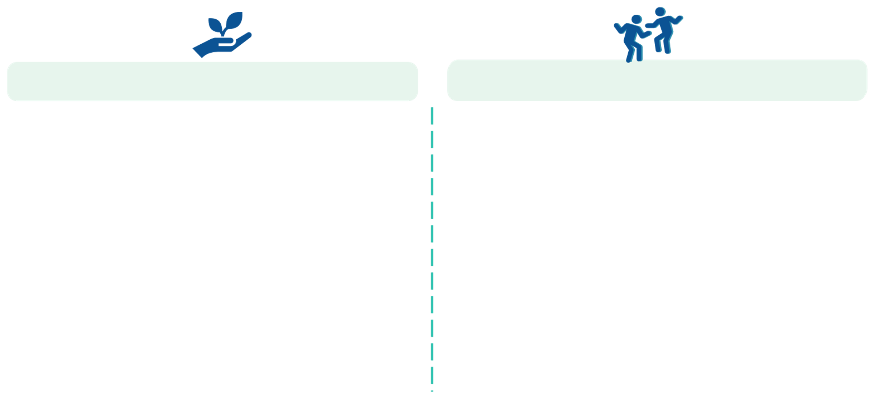
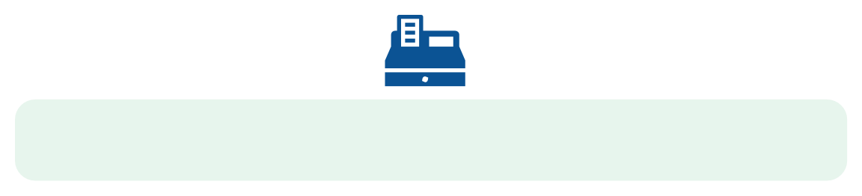





ESG Analysis
How we want to build the future.
Environment
Social
Governance
. Increasing Social Awareness on Zero Pollution Policy.
• Changing mindset over Manual Fish Feeding System.
• Ensure Technical Campaigns for Coastal areas Shrimp Hatcheries.
• Acting in the best of our customers.
. SDG Goal 8: Ensure Economic growth of small scale farmers.
• SDG Goal 13: Ensuring Zero air pollution
• SDG Goal 14: Ensuring Sustainable aquaculture.
• Partnering with Government and Hatcheries to advance sustainable drive.
• Long term goal: Zero Pollution Policy Implementation.
• Fostering Transparency and Ethics in Company Policy.
• Partnering up with Government institution- BFDC, MFA, LGD.
• Cultivating a Strong Risk and Control Environment.
Active participation to build a Sustainable Agriculture, where fish will grow perfectly.
1
14

Slide 15
Contingency Plan
Our plans to take on challenges
Analyze
Evaluate
Track
Measure
Keep change
and adapt
Category
Identified Risk
Mitigation
Knowledge about technology
Slow adaptation
Proper campaigns, placements
and marketing
Brand Image Creation
Totally new in market.
Boasting the positive environmental impact along with superior and innovative marketing strategies
Product repair and
maintenance
Product might need
maintenance frequently
Quality raw material and
strong customer service

